Slide 1
SQL PROJECT
On Pizza Sales
Solved various SQL Queries on Pizza Sales

Slide 2
Content:-
Basic:
Retrieve the total number of orders placed.
Calculate the total revenue generated from pizza sales.
Identify the highest-priced pizza.
Identify the most common pizza size ordered.
List the top 5 most ordered pizza types along with their quantities.
Intermediate:
Join the necessary tables to find the total quantity of each pizza category ordered.
Determine the distribution of orders by hour of the day.
Join relevant tables to find the category-wise distribution of pizzas.
Group the orders by date and calculate the average number of pizzas ordered per day.
Determine the top 3 most ordered pizza types based on revenue.
Advanced:
Calculate the percentage contribution of each pizza type to total revenue.
Analyze the cumulative revenue generated over time.
Determine the top 3 most ordered pizza types based on revenue for each pizza category.

Slide 3
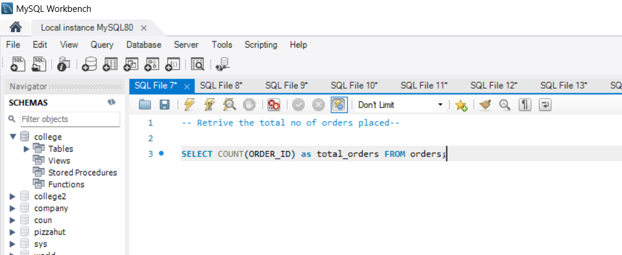
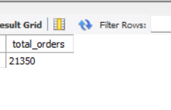
Query 1. Retrieve the total number of orders placed.
Output

Slide 4
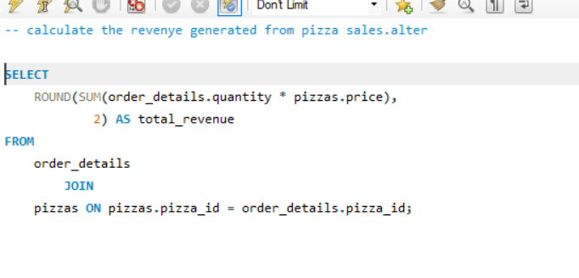
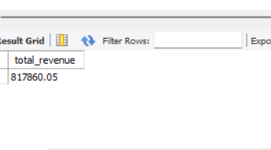
Query 2. Calculate the total revenue generated from pizza sales.
Output

Slide 5
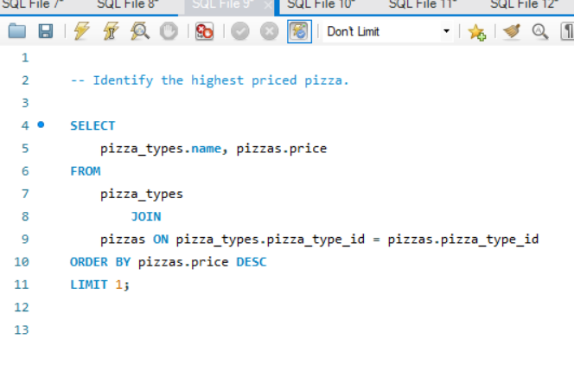
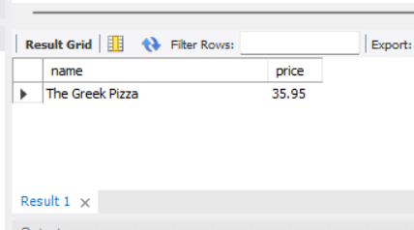
Query 3. Identify the highest-priced pizza.
Output

Slide 6
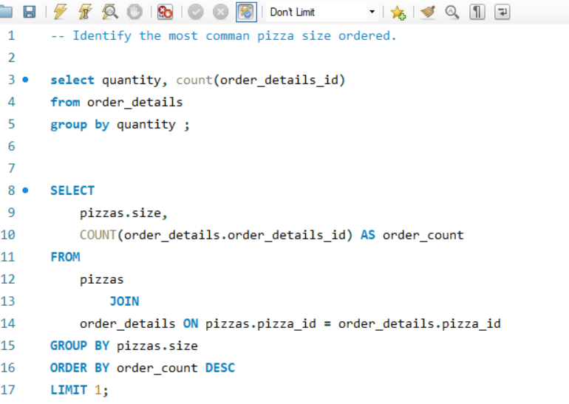
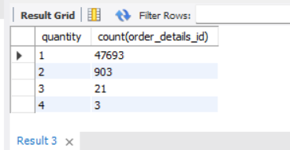
Query 4. Identify the most common pizza size ordered.
Output

Slide 7
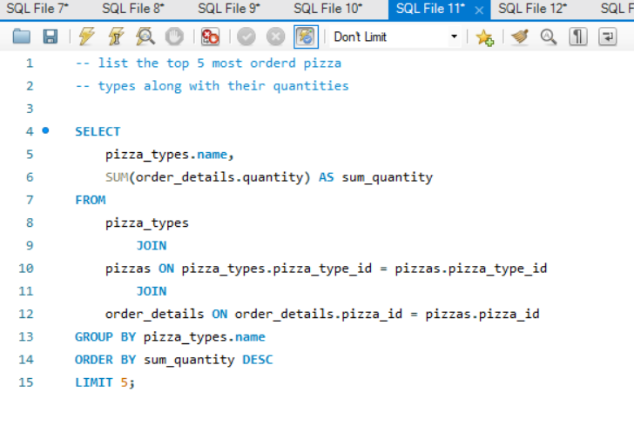
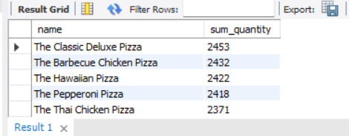
Query 5. List the top 5 most ordered pizza types along with their quantities.
Output

Slide 8
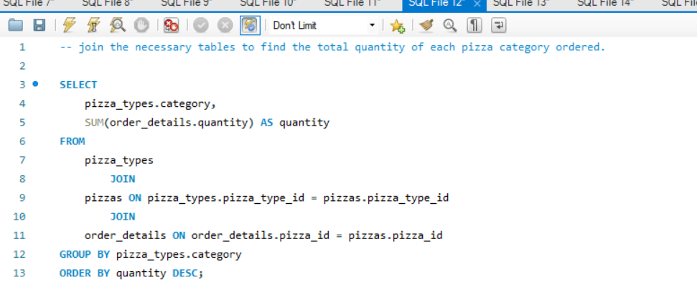
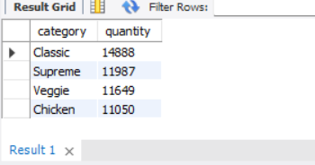
Query 6. Join the necessary tables to find the total quantity of each pizza category ordered.
Output

Slide 9
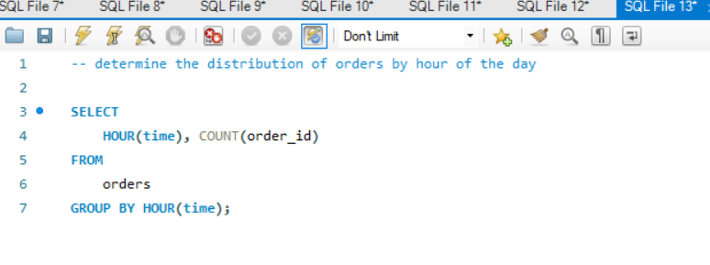
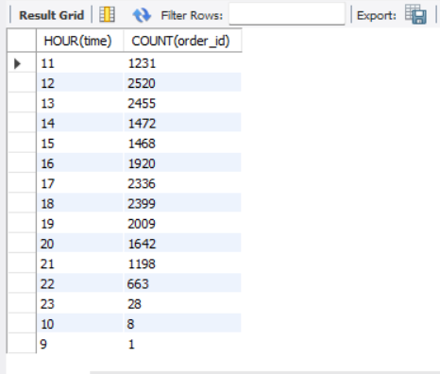
Query 7. Determine the distribution of orders by hour of the day.
Output

Slide 10
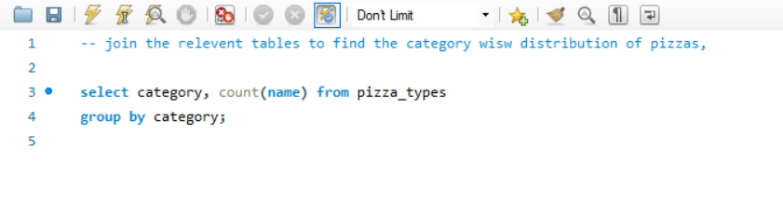
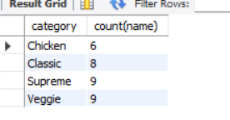
Query 8. find the category-wise distribution of pizzas.
Output

Slide 11
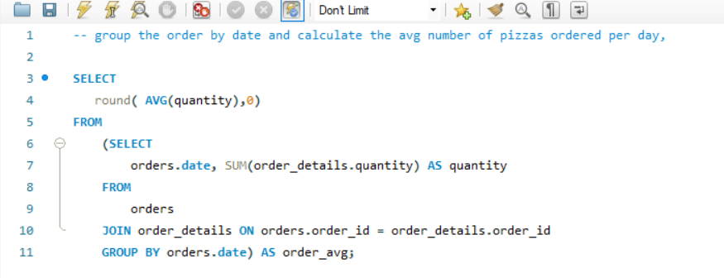
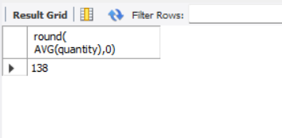
Query 9. Group the orders by date and calculate the average number of pizzas ordered per day.
Output

Slide 12
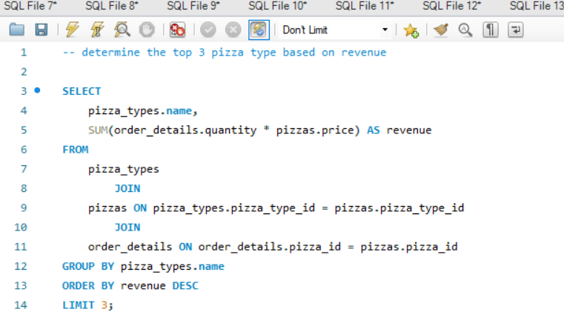
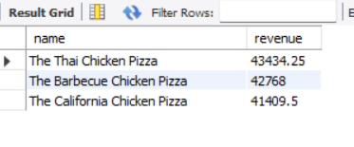
Query 10. Determine the top 3 most ordered pizza types based on revenue.
Output

Slide 13
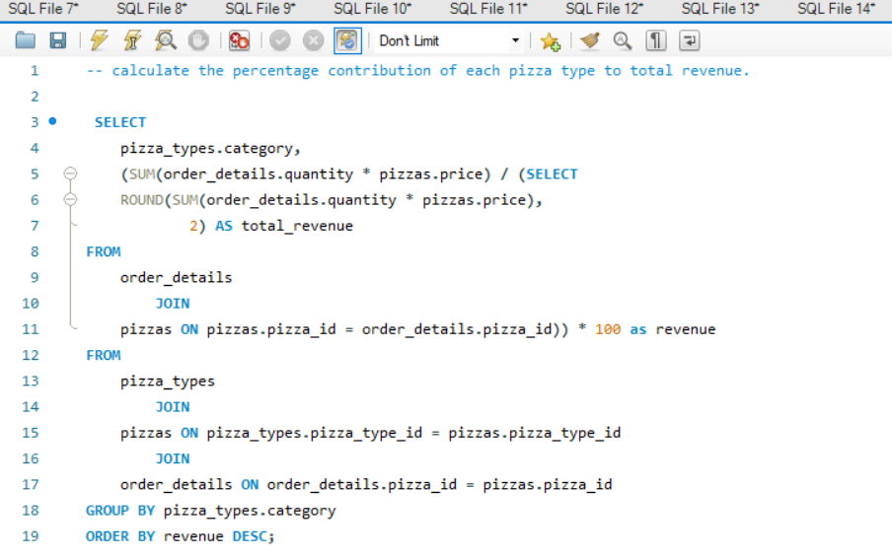
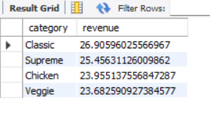
Query 11. Calculate the percentage contribution of each pizza type to total revenue.
Output

Slide 14
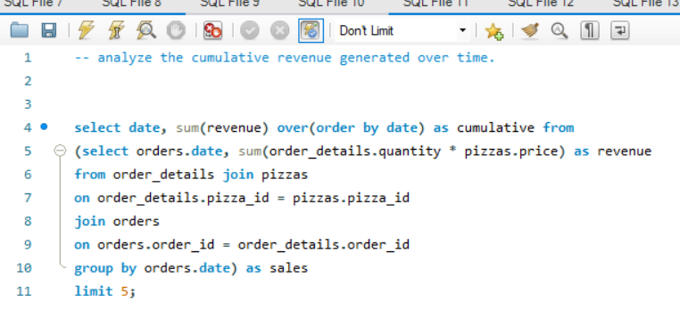
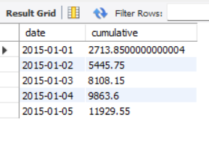
Query 12. Analyze the cumulative revenue generated over time.
Output

Slide 15
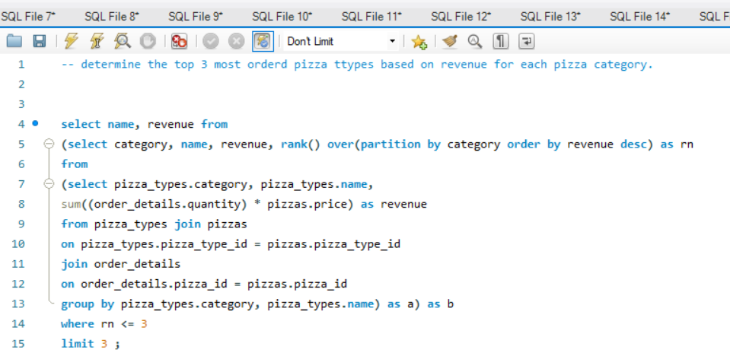
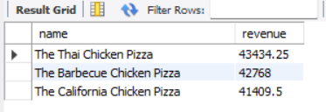
Query 13. Determine the top 3 most ordered pizza types based on revenue for each pizza category.
Output

Slide 16
THANK YOU

